Slide 1
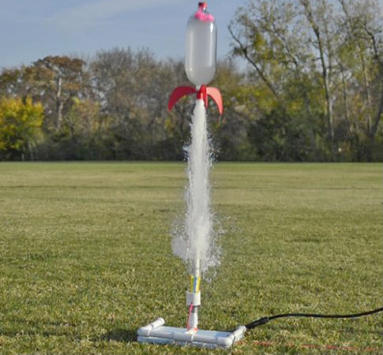
Mission Analysis
Pierre Seeleuthner – ISAE

Slide 2
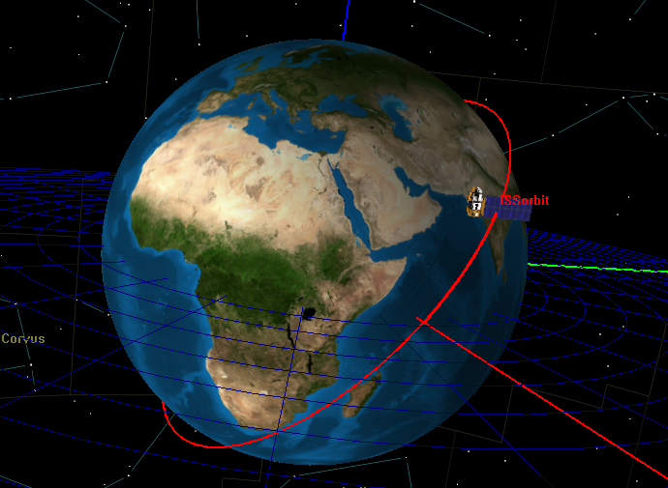
Orbit Choice:
Orbital parameter
Semi-major axis (a) | 6478 km
Inclination (i) | 51.64°
Right Ascension of Ascending node | 105°
Period | 90 min
ISS orbit parameters

Slide 3
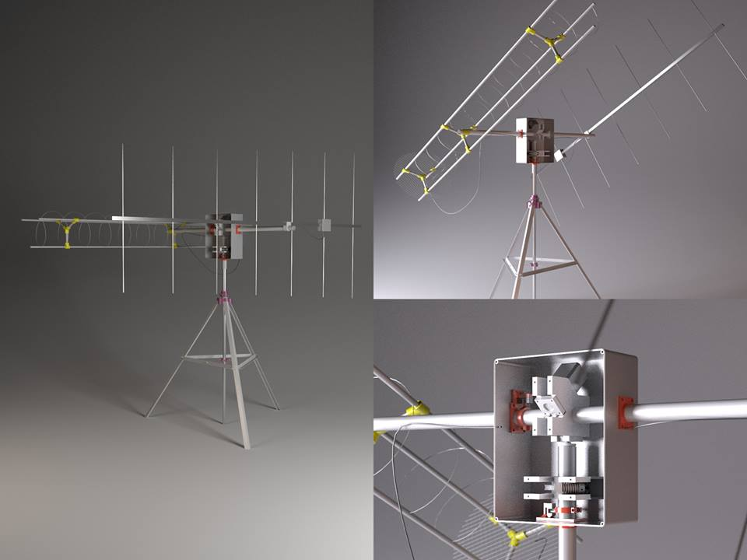
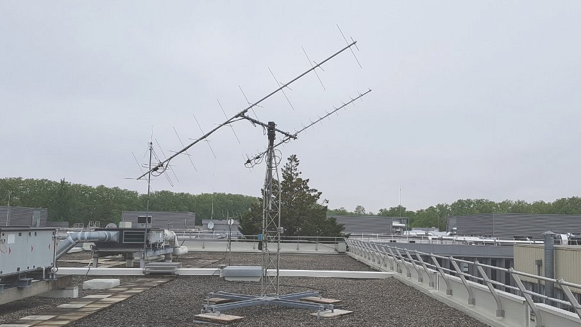
Ground station
UHF/VHF ground station located in Toulouse:
Supaero’s UHF/VHF or ASTRE’s ASTRENOGS
Supaero’s UHF/VHF Ground station – ISAE-SUPAERO
3D-render Astrenogs - ASTRE

Slide 4
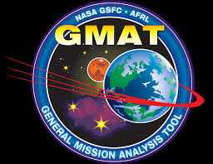
Orbital Simulations
Spacecraft | Spinning 2U Cubesat Cd = 2.1 Launch on 01/01/2024
Propagator | Numerical propagator Integrator: Dormant-Prince 78
Force Model | 10x10 JGM 2 gravity Moon+Sun influence MSISE90 drag model corrected with space weather files Solar radiation pressure
Simulations using NASA’s General Mission analysis Tool (GMAT)

Slide 5
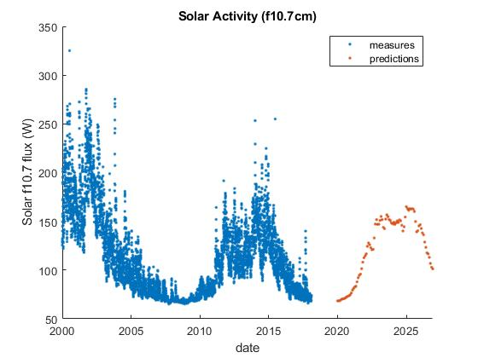
Launch Date vs Solar Activity
2024
2019

Slide 6
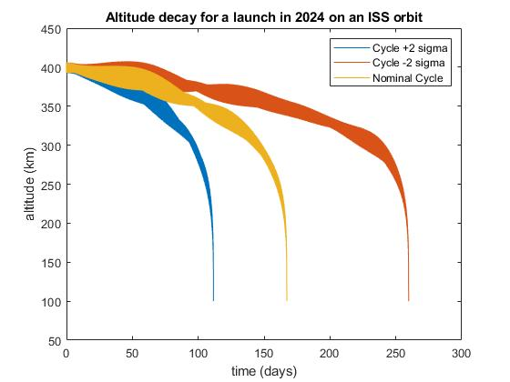
TOLOSAT’s lifespan
This plot gives you the lifespan while taking into account the uncertainty on the solar activity:
Nominal case: around 160 days
-2σ case (pretty pessimistic): around 110 days
+2σ case (pretty optimistic): around 250 days

Slide 7
Other results
Mission duration | 160 days
Mean eclipse duration | 32 minutes
Visibility Sessions with Toulouse ground station | 3 sessions/day
Total visibility time per day | 18 minutes

Slide 8
Other orbit possibility: Polar orbit at 500km
PROS | CONS
ISS might not be there anymore | More Expensive
We might not be selected to FYS | Longer Lifespan (almost 10 times longer)
Polar orbit is better suited for Earth Observation | Lower Resolution for the gravimetry measurements
Polar orbit allows better visibility wrt the Iridium constellation

Slide 9
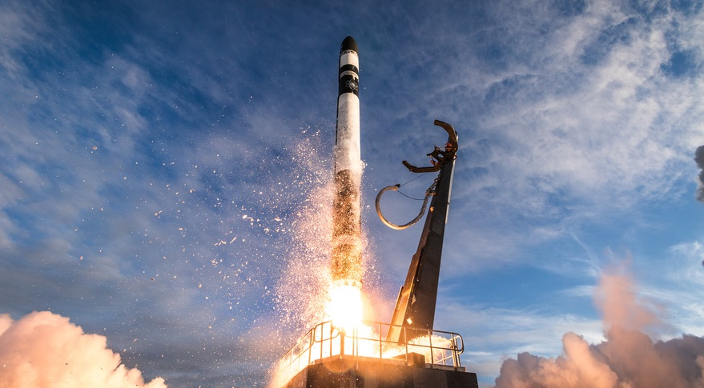
Thank You !
Electron Launch – Rocket Lab

Slide 10
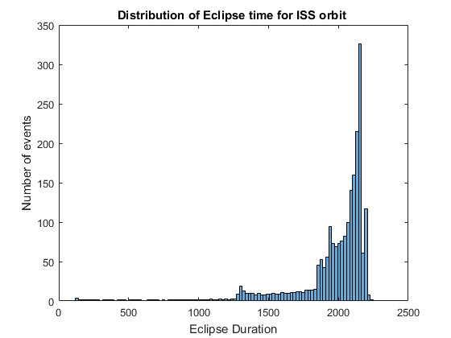
Eclipse duration

Slide 11
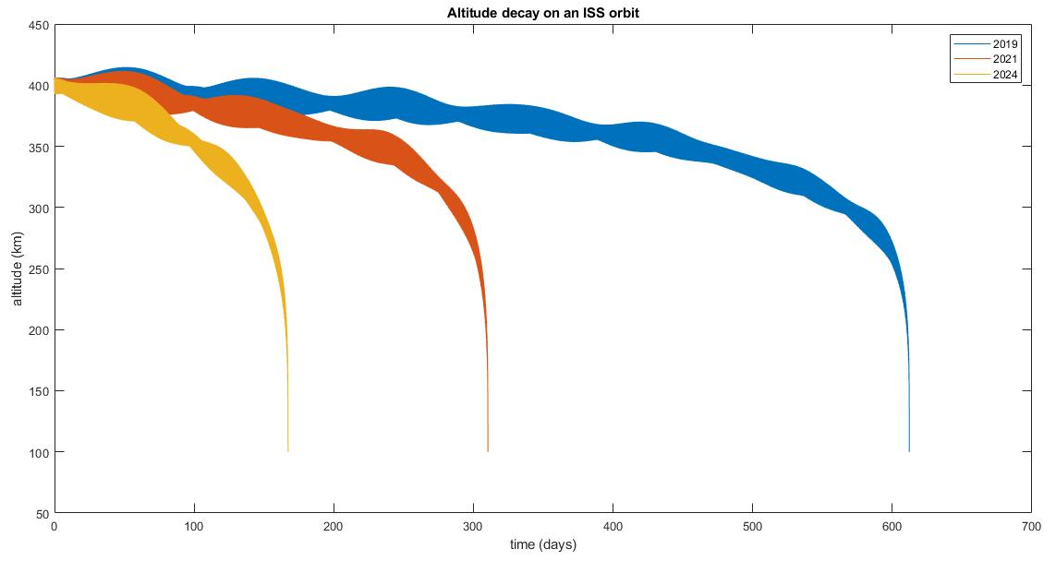
I ran simulations on a few different launching dates (ISS orbit at 400 km)
01/01/2024
01/01/2021
01/01/2019
~160 days
~300 days
~600 days

Slide 12
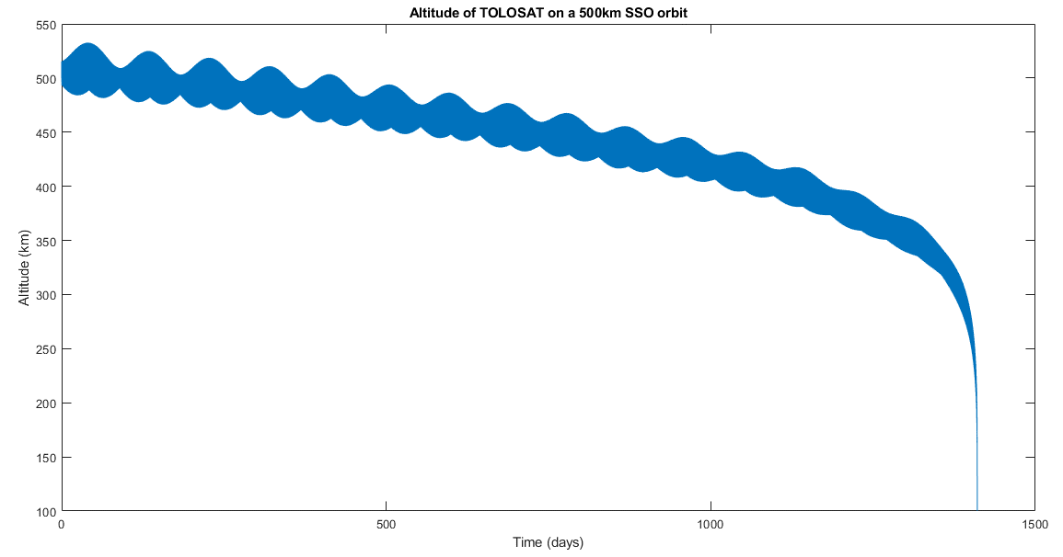

Slide 13
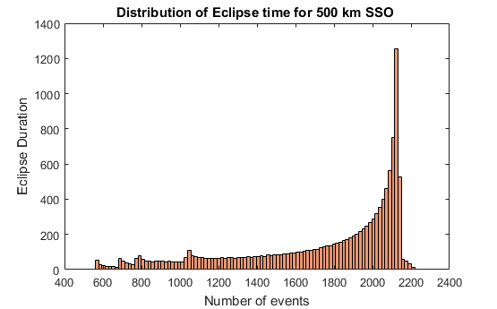

Slide 14
